Slide 1
Water Quality PREdiction
Team Members :
Mr. Yeshwanth R
Mr. Thanuja KM
Mr. Ashwin
Mr. Vinod
Mr. Mallikarjun
Mr. Aditya K
Mentor Name : Mr.Ritesh

Slide 2
BUSINESS
PROBLEMS
Access for safe water drinking is basic need for humans, less than 50 percent of the population in India has access to safely managed drinking, water quality is a serious issue to be considered and we need to consider many factors to have a safe drinking water.

Slide 3
BUSINESS
OBJECTIVE
This is a classification project since the variable to be predicted is binary (water potable or not potable). The Objective here is to Predict water probability, conditioned on the water quality features.

Slide 4
PROJECT ARCHITECTURE
Collection of Data
Busniess Understanding
Exploratory Data Analysis(EDA)
Deployment
Model Building

Slide 5

DATA SET DETAILS
The data file Water_Potability.csv contains a total of 10 features for 3276 samples. Each row corresponds to a sample values of a Water quality index for which it has been collected information about the type of quality index.

Slide 6
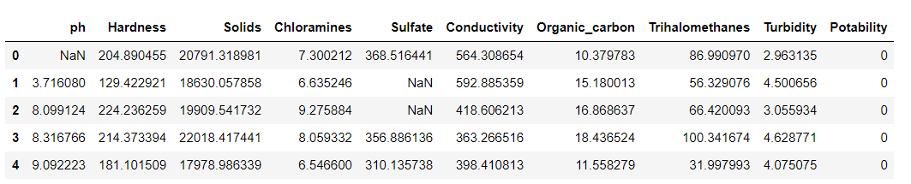
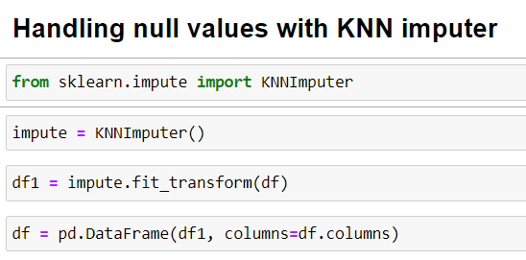
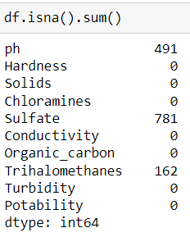
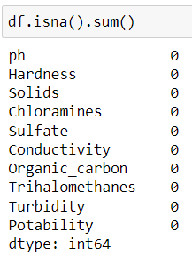
The Data set contains 3276 Rows and 10 Columns
Null values are handled by using KNN imputer

Slide 7
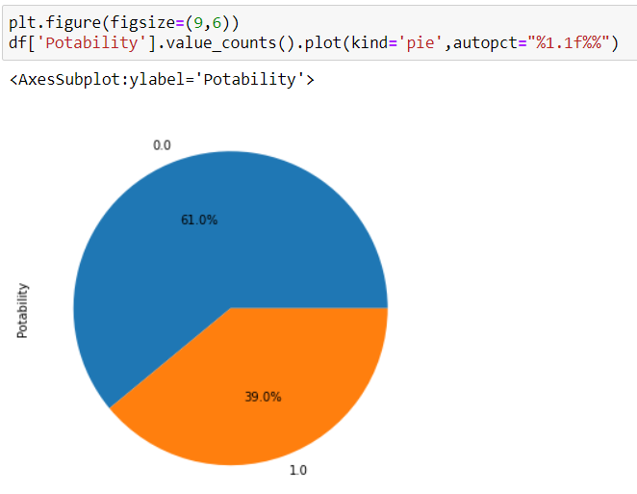
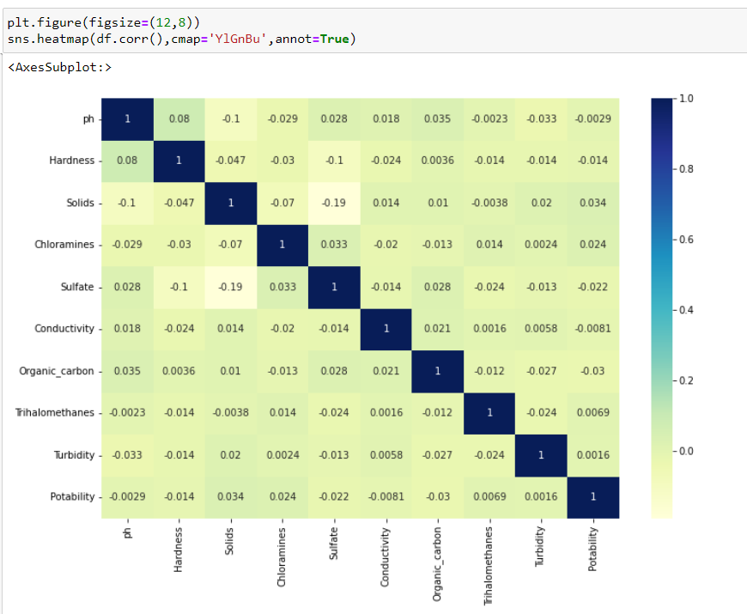
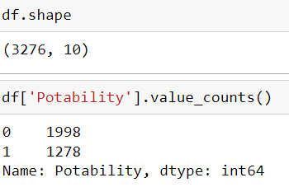
EDA VISUALIZATIONS
Potability is 39.0% , Whereas Non-Potability is 61.0%
Correlation Between the independent Variables

Slide 8
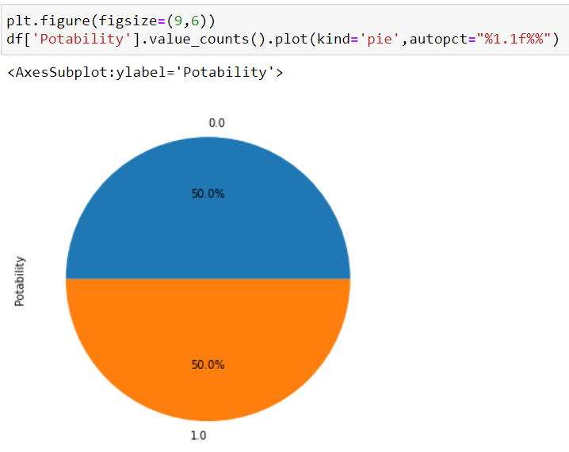
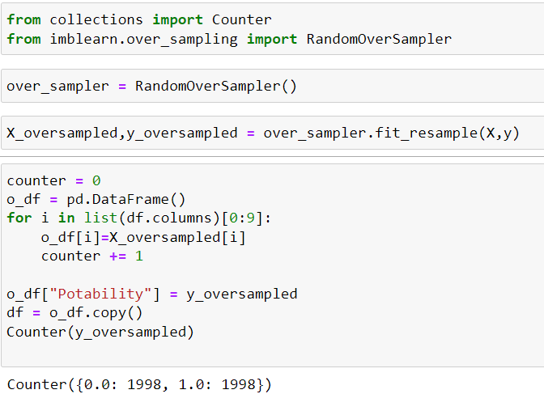
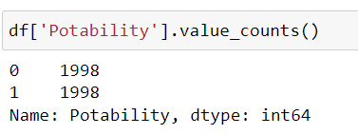
Applying the Random over sampling method to balance the dataset

Slide 9
MODEL BUILDING

Slide 10
Models Used For Model Building
Logistic Regression
Random Forest
Decision Tree
SVM Model
XGBM Boosting
LGBM Boosting

Slide 11
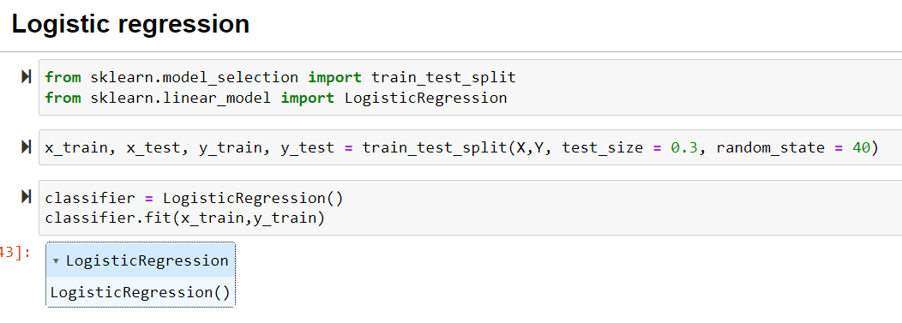
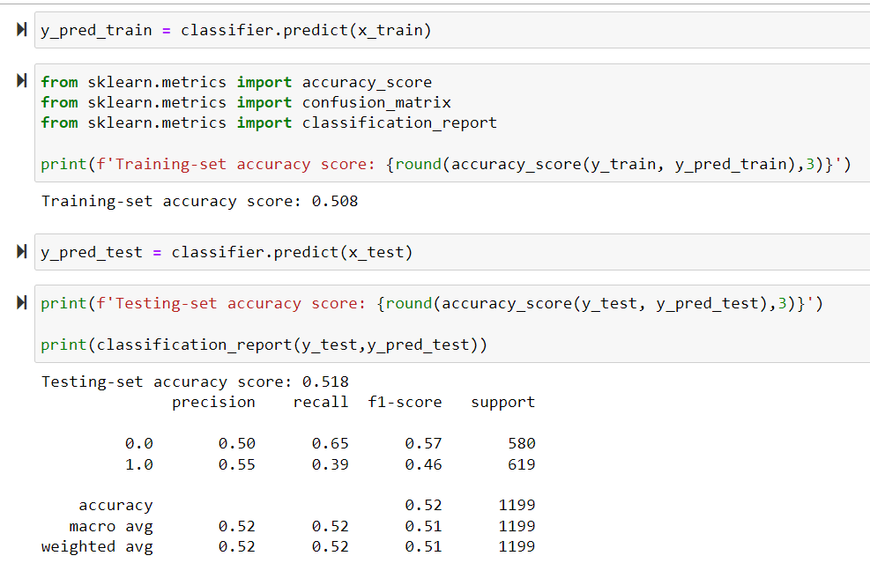
Logistic Regression
Accuracy is 50% for training and 51% for the testing data.

Slide 12
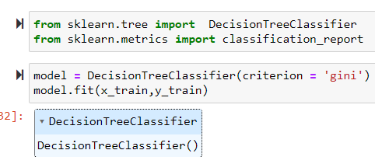
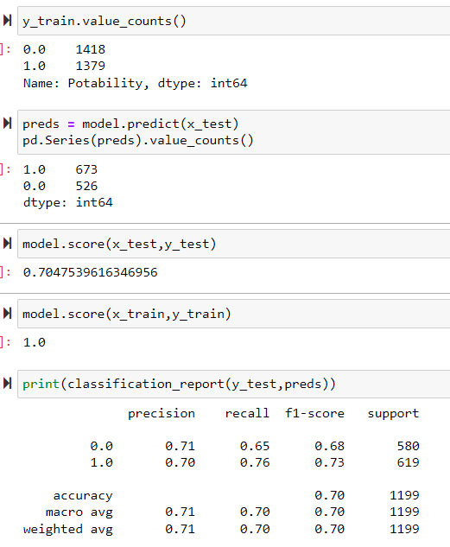
DECISION TREE
Accuracy of Decision tree Classifier is 100% for training data and 70% for testing data.

Slide 13
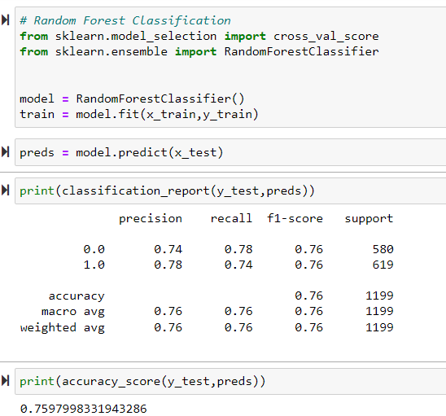
Random Forest
For Random forest accuracy is 76%

Slide 14
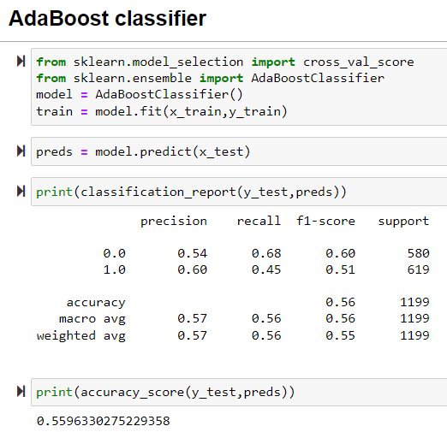
AdaBoost Classifier
Accuracy for AdaBoost classifier is 56%

Slide 15
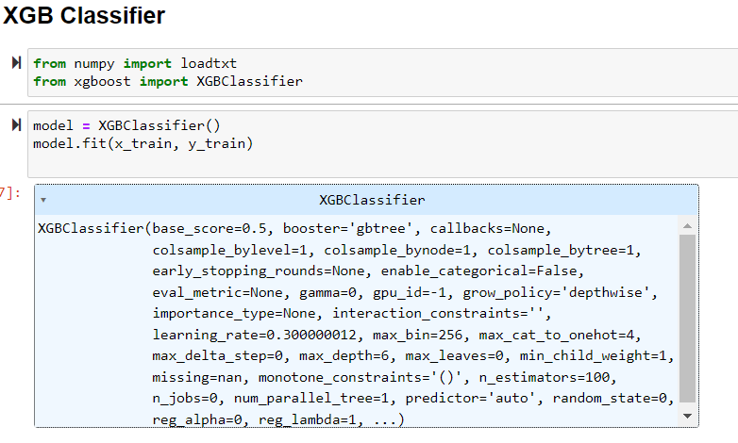
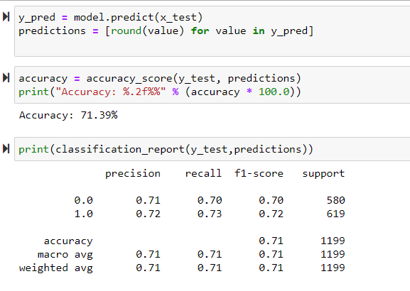
XGB Classifier
Accuracy for XGB classifier is 71.39%

Slide 16
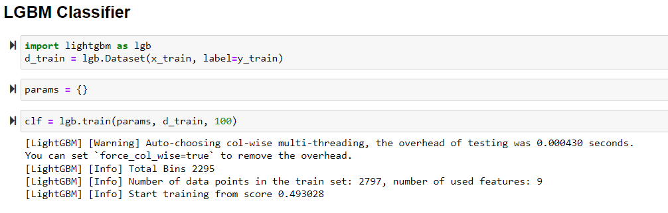
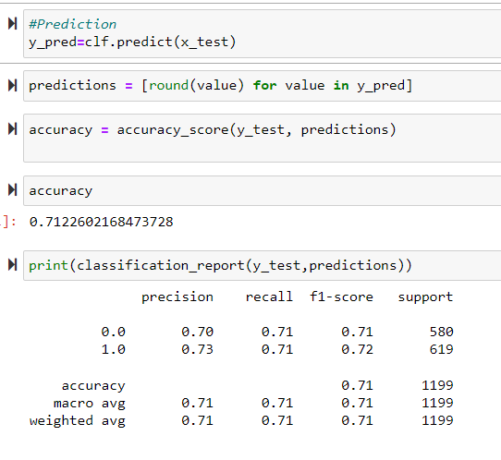
LGBM Classifier
Accuracy for LGBM Classifier is 71.2%

Slide 17
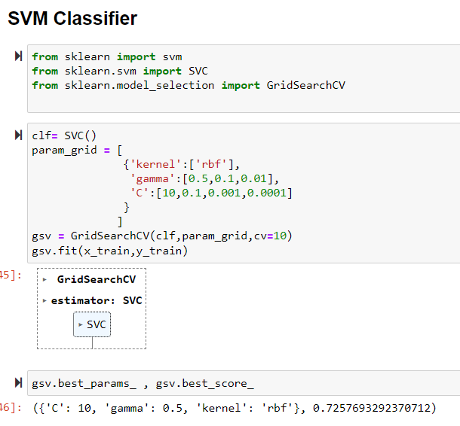
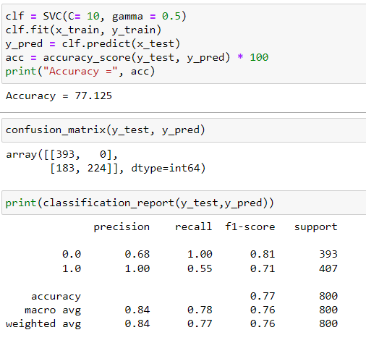
SVM MODEL
Accuracy for SVM Model is 77%
We found out that SVM has the high accuracy of 77%, So we agreed proceed to deployment with SVM model

Slide 18
After the Model building and Evaluation process, we have deployed the code using “Streamlit”.
DEPLOYMENT
We have selected the best model(SVM Classifier) and used in our deployment
phase.

Slide 19
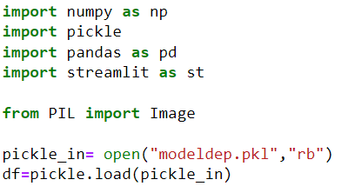
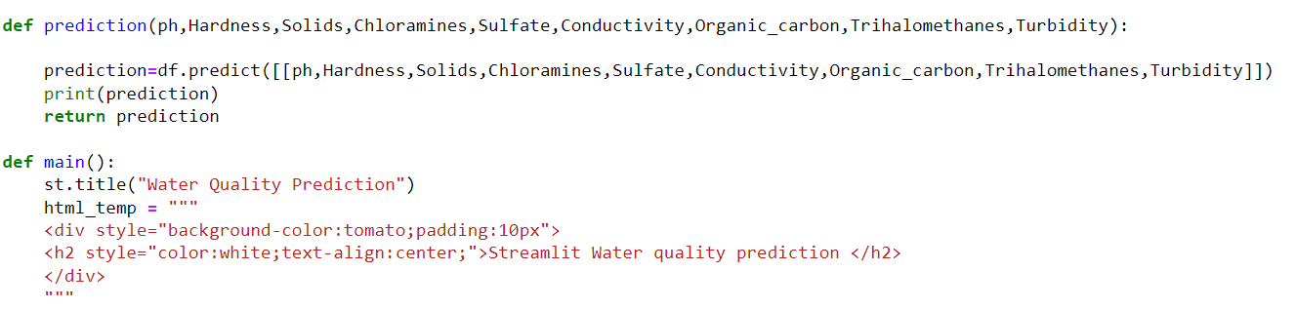

Slide 20
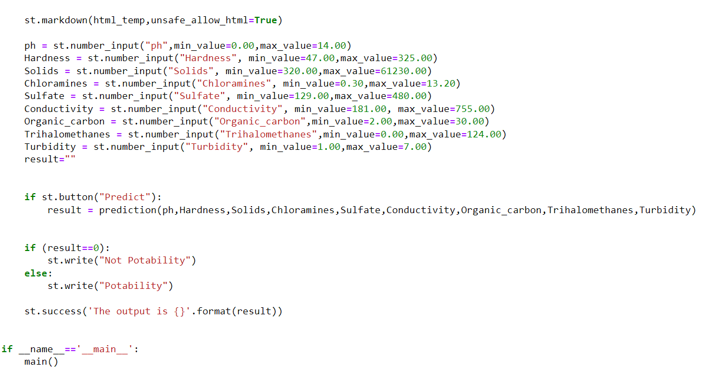

Slide 21
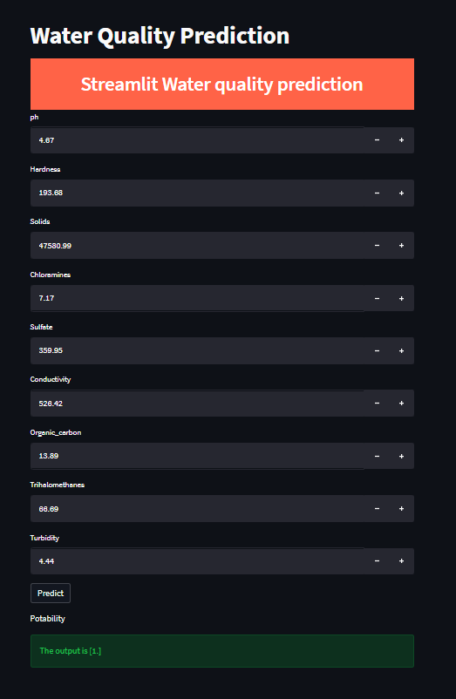
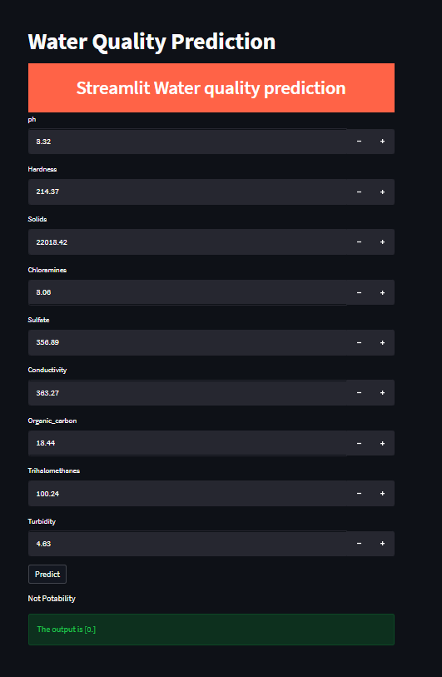

Slide 22
THANK YOU !!

